Slide 1
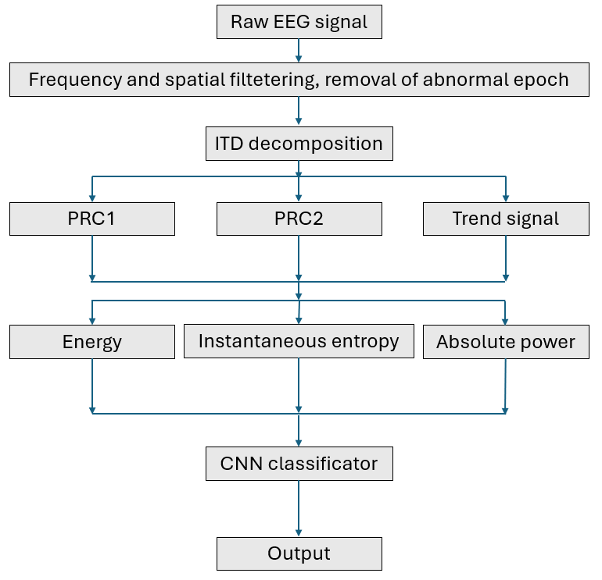
EEG motor imagery classification: Intrinsic time-scale decomposition and CNN Model
Common average reference
Proper Rotation Component

Slide 2
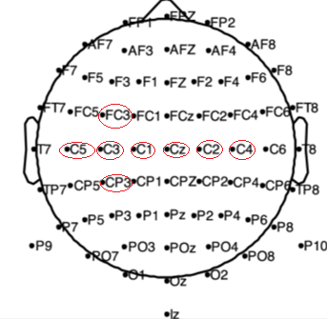
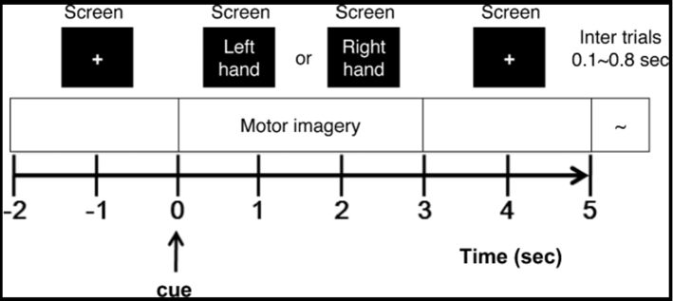
EEG datasets for motor imagery brain–computer interface
Epoch
Selected channels

Slide 3
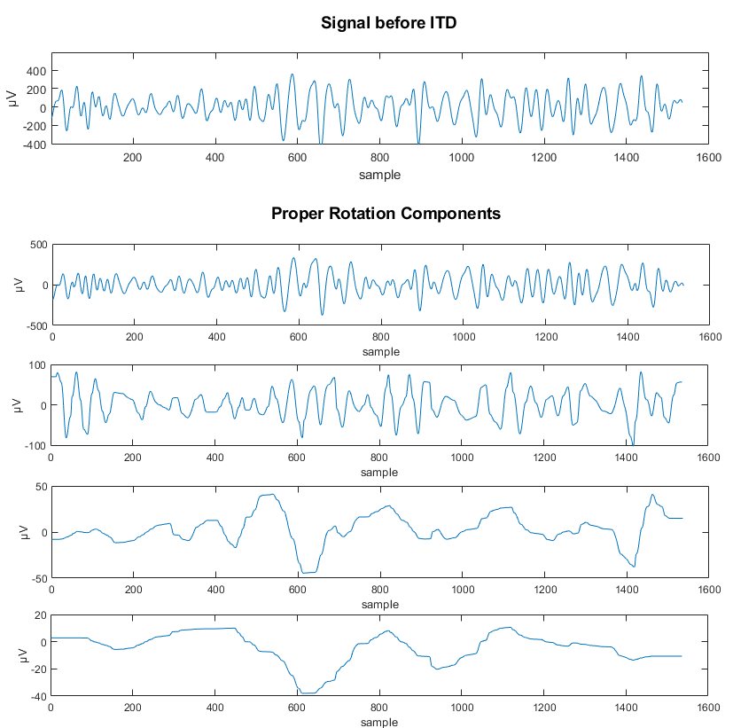
Example of intrinsic time-scale decomposition

Slide 4
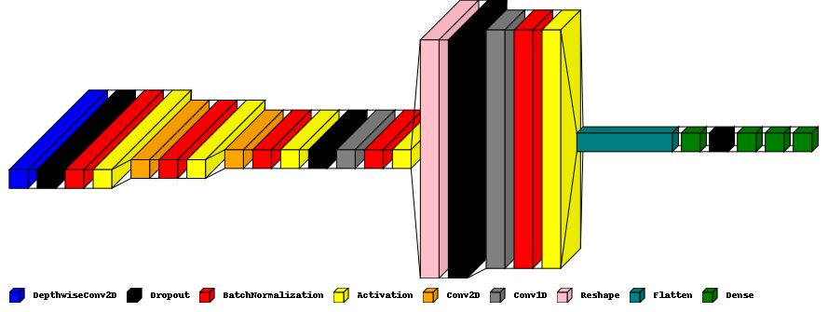
CNN Model
Input:32x8x3
Output:1 (boolean)

Slide 5
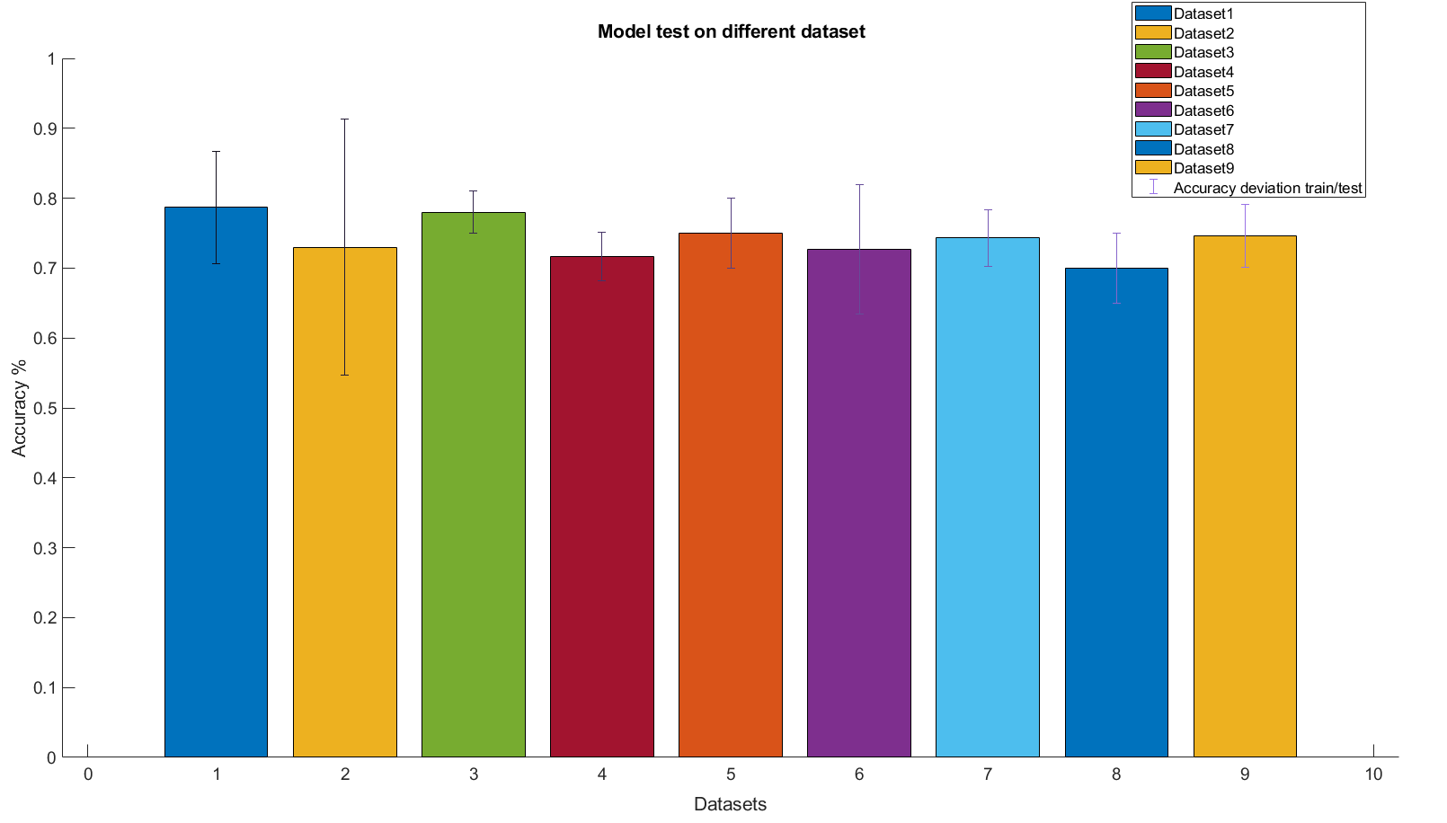
Results: (in working)

